Slide 1
BOBCAT TIME
April 7 and 8, 2026
STAAR Testing Information

Slide 2
BOBCAT TIME
April 7- slides 2- 11

Slide 3

STAAR TESTING DATES
April 14- 7th and 8th grade ELA
April 15- 6th grade ELA
April 21- 8th grade Science/Bio
April 22- 8th grade Social Studies
April 28- 8th grade Math/Algebra
April 29- 6th grade Math, 7th grade
Math, 7th grade AAC Math (takes
8th grade STAAR)

Slide 4

STAAR Reminders and Expectations
All students testing on the dates below will need a sack lunch:
April 14- 7th and 8th grade
April 15- 6th grade
April 29- 6th and 7th grade
All other dates students will be eating in the cafeteria.
Students that need a sack lunch will have a chance to pre-order lunches tomorrow. Ask your parents tonight if you need to order a lunch or if you will bring a sack lunch.
Lunches CAN NOT be delivered to students on any testing day. PLAN AHEAD and bring lunch.
Microwaves WILL NOT be available to students on testing days.

Slide 5
STAAR Reminders and Expectations
April 14- 6th gr eats A lunch. 7th and 8th gr eats at 12:00pm in testing room. 7th and 8th graders need sack lunches.
April 15- 7th and 8th gr eats B and C lunch as normal. 6th gr eats at 11:00am in testing room. 6th graders need sack lunches.

Slide 6
STAAR Reminders and Expectations
April 21 and 22- 8th gr students who are not finished testing will eat lunch in the testing room. A, B, C lunches normal. No sack lunches needed.

Slide 7
STAAR Reminders and Expectations
April 28- 6th graders will eat A lunch. ALL 7th graders will eat B lunch (even if you normally eat C lunch). 8th graders that are done testing will eat C lunch. 8th graders that are not done testing will eat the in testing room.
April 29- 6th and 7th graders will eat in the testing room at 11am. 8th graders not going to the Great Wolf Lodge will eat in their assigned rooms.

Slide 8
STAAR Reminders and Expectations
During the lunches, teachers will get a count of the number of students still testing. Many times at the end of lunch, we move the students who are still testing into another room. We will have the library available for students who are still testing.

Slide 9
STAAR Reminders and Expectations
No lockers during testing times.
Students can go to their locker before 1st, before lunch and after testing.
No tutorials on testing days for ANY grade level.
April 14, 15, 21, 22, 28, and 29.

Slide 10

STAAR Reminders and Expectations
On all STAAR testing days, FCMS will be in a testing environment
All Bobcats are asked to be QUIET in the halls
Some bathrooms will be only for testing students
Some hallways will be closed for testing rooms and testing students only
Some teachers will move rooms for testing

Slide 11
Testing Rooms- if there is time
Teachers- please give each student their testing room assignment.
All teachers have the testing list so ask any teacher.
Ms. Willett will be at lunch to provide room numbers for students if you don’t have time this week to get your room numbers.
Students should write down the room number.

Slide 12
BOBCAT TIME
April 8- slides 13- 21

Slide 13
STAAR Lunch count
Teachers please ask the students how many students will need a sack lunch for testing days.
At this time, we do not know what the sack lunch will be. There will be a regular and a vegetarian option.
Complete the 2 question form so we can get a count of the number of lunches to prepare. STAAR Lunch Form 2026

Slide 14

STAAR Reminders and Expectations
It is important for all students taking a STAAR assessment to be on time (before 8:50 am) and be in attendance all day until dismissal at 4:10 pm.
When you arrive early, you have extra time to prepare for testing and can calmly enter your testing room.

Slide 15
STAAR Reminders and Expectations
Make sure you charge your laptop the night before your test.
Bring your laptop AND your charger with you on test days. FCMS does not have chargers for you to borrow.
Only students who are STAAR testing will be able to check out a day-use laptop in the morning. If we run out of loaners you will have to test on a makeup day.
Make sure you check your computers to see if you need any updates.

Slide 16
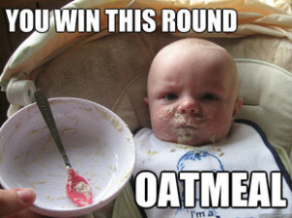
STAAR Reminders and Expectations
Students should come to school well rested after a good night’s sleep of at least 8-10 hours.
Eat a healthy breakfast, not just junk food and sugary items.
Your lunch may be later than you normally eat.

Slide 17

STAAR Reminders and Expectations
Bring a book if you want to read after testing
You can only read (not e-reader or from phone) or sleep/rest after you turn in your test
Phones should be left in your locker or must be turned into testing teacher
You will NOT be able to play games or work on your laptop while we are still testing.

Slide 18
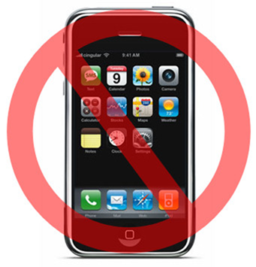
STAAR Reminders and Expectations
An email was sent home informing you and your parent/guardian of Texas Education Agency’s (TEA) and Fort Bend Independent School District’s policy in regards to cell phones and standardizing test including STAAR testing.
You will not get a score for the STAAR test if you are caught with a cell phone or smart watch while testing.

Slide 19
STAAR Reminders
Your teachers have given you many strategies during the school year, make sure you use them.
Take your time on the STAAR test. There is no need to rush. There is no prize for finishing the test 1st.
Take small breaks during your test in order to keep your mind sharp.
Remember you are allowed to ask for scratch paper on any STAAR test.

Slide 20
HB1416
House Bill 1416 states that any student who does not pass the STAAR test will need to have 30 hours of extra intervention for EACH subject that you fail.
Some students are getting those extra hours now in Bobcat time, 7:30am morning tutorials or math lab/literacy class.
Make sure you take the test serious and do your best.
Take your time, check your work, redo problems, etc…

Slide 21
Testing Rooms
Teachers- please give each student their testing room assignment.
All teachers have the testing list so ask any teacher.
Ms. Willett will be at lunch to provide room numbers for students if you don’t have time this week to get your room numbers.
Students should write down the room number.

